Slide 1

J K K NATTRAJA COLLEGE OF ENGINEERING AND TECHNOLOGY
Team Members:
A.PRAGALANATHAN
M.PAISAL RAHUMAN
M.GOWTHAM
S.KARTHIK
S.DHILIP SANJAY
Mentor:
MURUGASHANKAR S AP/IT
Domain : Applied Data Science
Title: Predicting IMDB Scores

Slide 2
Abstraction:
Predicting Internet Movie Database (IMDb) scores for movies or TV shows based on content is a complex task that involves analyzing various elements of the content itself, as well as external factors. IMDb scores are determined by user ratings and reviews, making them subjective and influenced by a multitude of factors. Here is a condensed overview of key considerations when predicting IMDb scores based on content

Slide 3
Description:
IMDb is a popular website that provides information about movies, TV shows, actors, directors, and other aspects of the entertainment industry. It offers details like cast and crew, plot summaries, user ratings, reviews, and more, making it a go-to resource for movie enthusiasts and industry professionals.

Slide 4
About Project
source:
Predicting IMDB scores from kaggle
Data Sets:
In this process we perform a load the data into pandas and preprocessing then other actions

Slide 5
About Project
Handling Missing Data:
Check for missing data in the dataset and decide how to handle it. You may impute missing values with reasonable estimates or remove rows with missing data
Handling Imbalanced Data:
If you have imbalanced IMDb score categories (e.g., too many high or low scores), consider techniques like oversampling or undersampling to balance the dataset

Slide 6
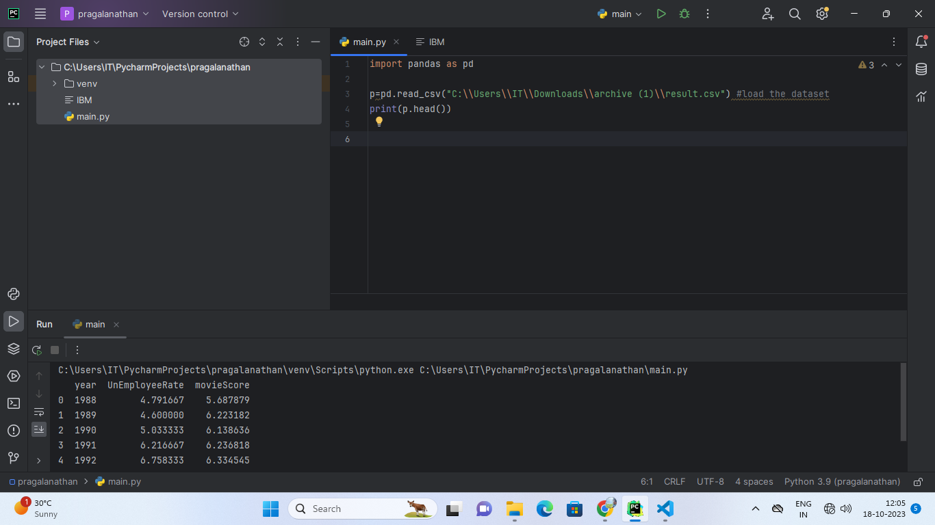
CODE:
Importing pandas and loading the data sets

Slide 7
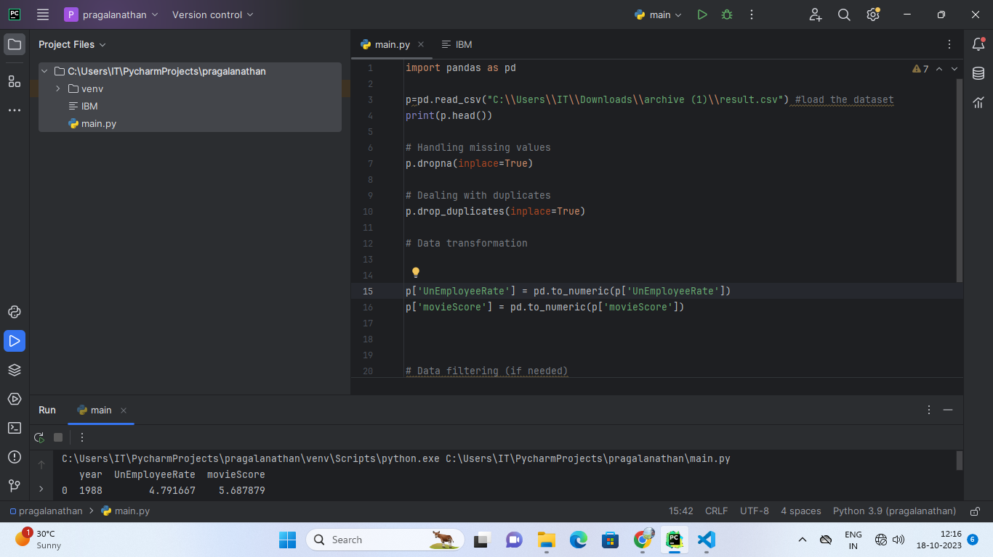
CODE:
Preprocessing the data and analysis

Slide 8
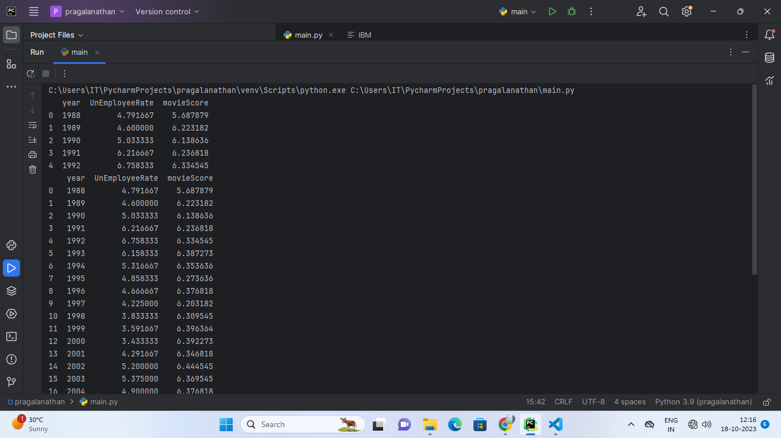
OUTPUT:

Slide 9
THANK YOU…

